Slide 1
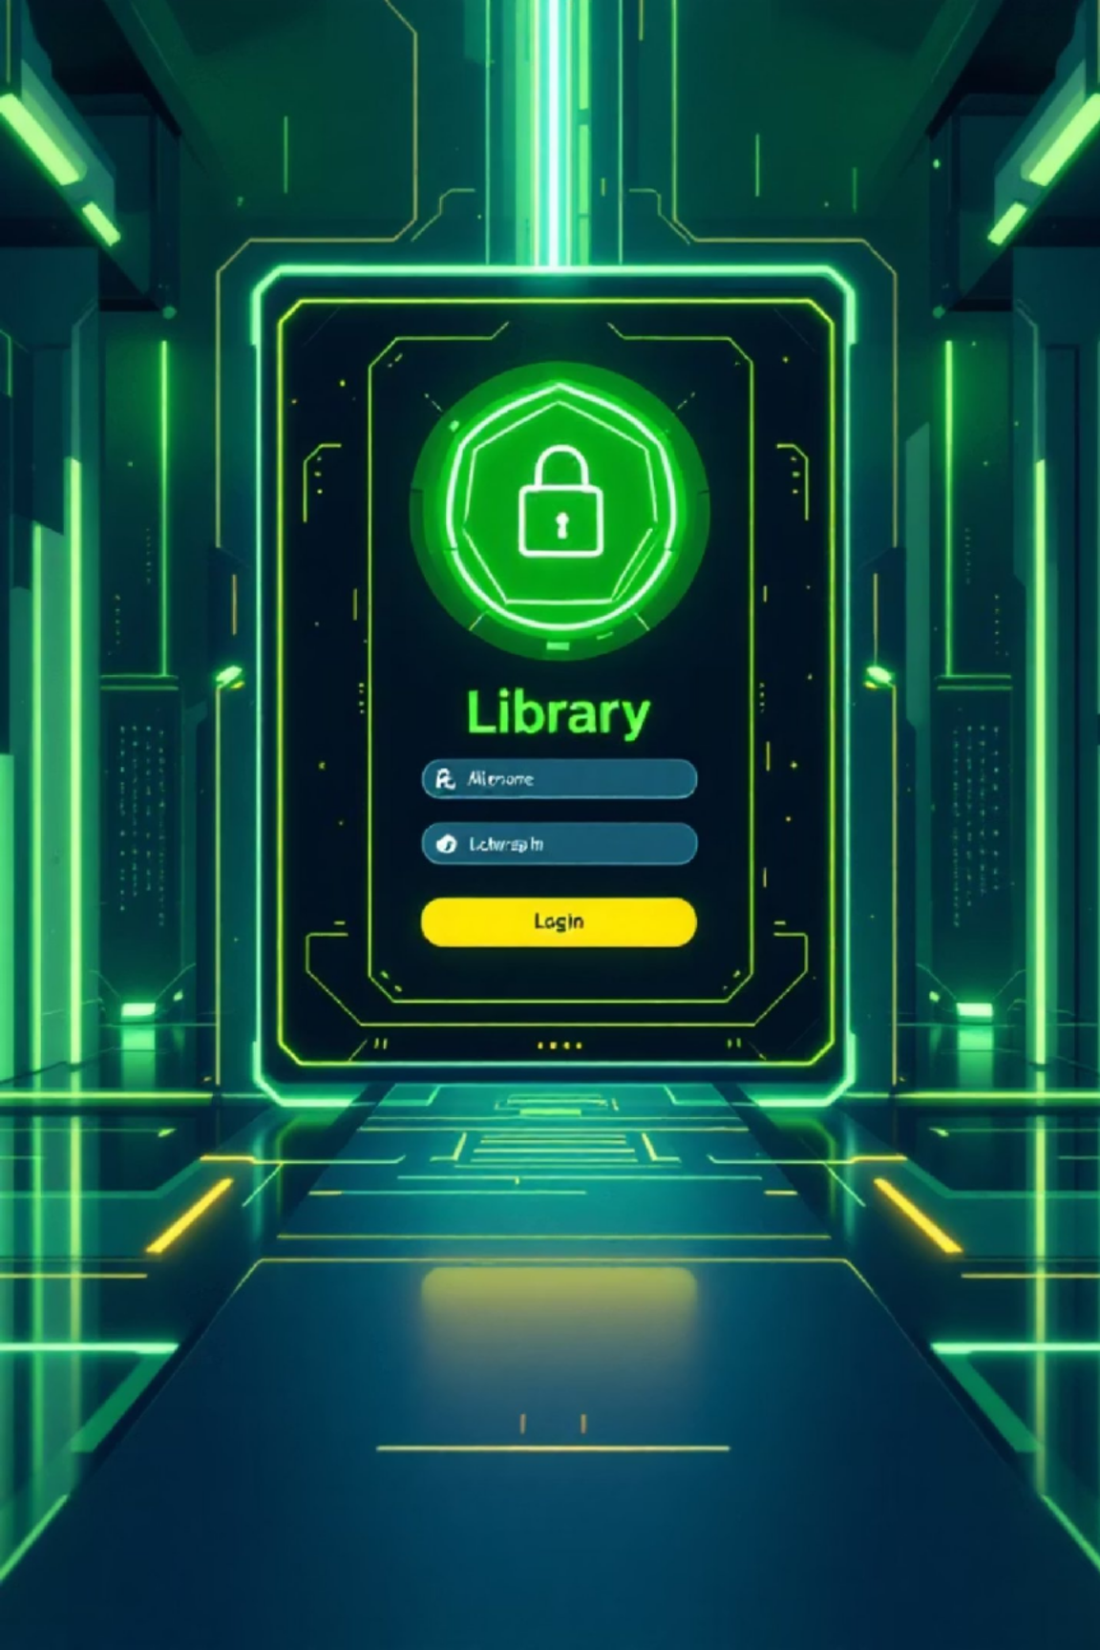
Library Login Portal
A Simple Web-Based Library Management System
Presented by:
S Rushi _2403a51028
T Varun _2403a51022
N Sai Varshith _2403a51013
Presented by: [Your Name], [Roll Number], [Class] Course: Web
Technologies / Mini Project Institution: [Institution Name]

Slide 2


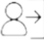

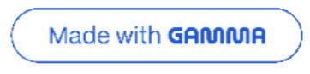
Introduction: Digitalizing Library Management
Digitalization
Transforming manual library processes into a streamlined digital experience.
Access Control
Separate, secure login access for both students and staff members.
Book Management
Enabling staff to manage inventory, and students to view and search for books.
Our goal is to create an intuitive, browser-based library management portal using HTML, CSS, and JavaScript.

Slide 3
Project Objectives: Crafting a Seamless Experience
User-Friendly Design
Dynamic Book Listing
Staff Capabilities
Develop an intuitive login portal for all users, ensuring ease of navigation.
Display and maintain an up-to-date list of all available books.
Empower staff to add, delete, and modify book records efficiently.
Student Search
Client-Side Focus
Allow students to easily search for books by author name.
Implement all functionalities using only JavaScript for a pure frontend solution.

Slide 4



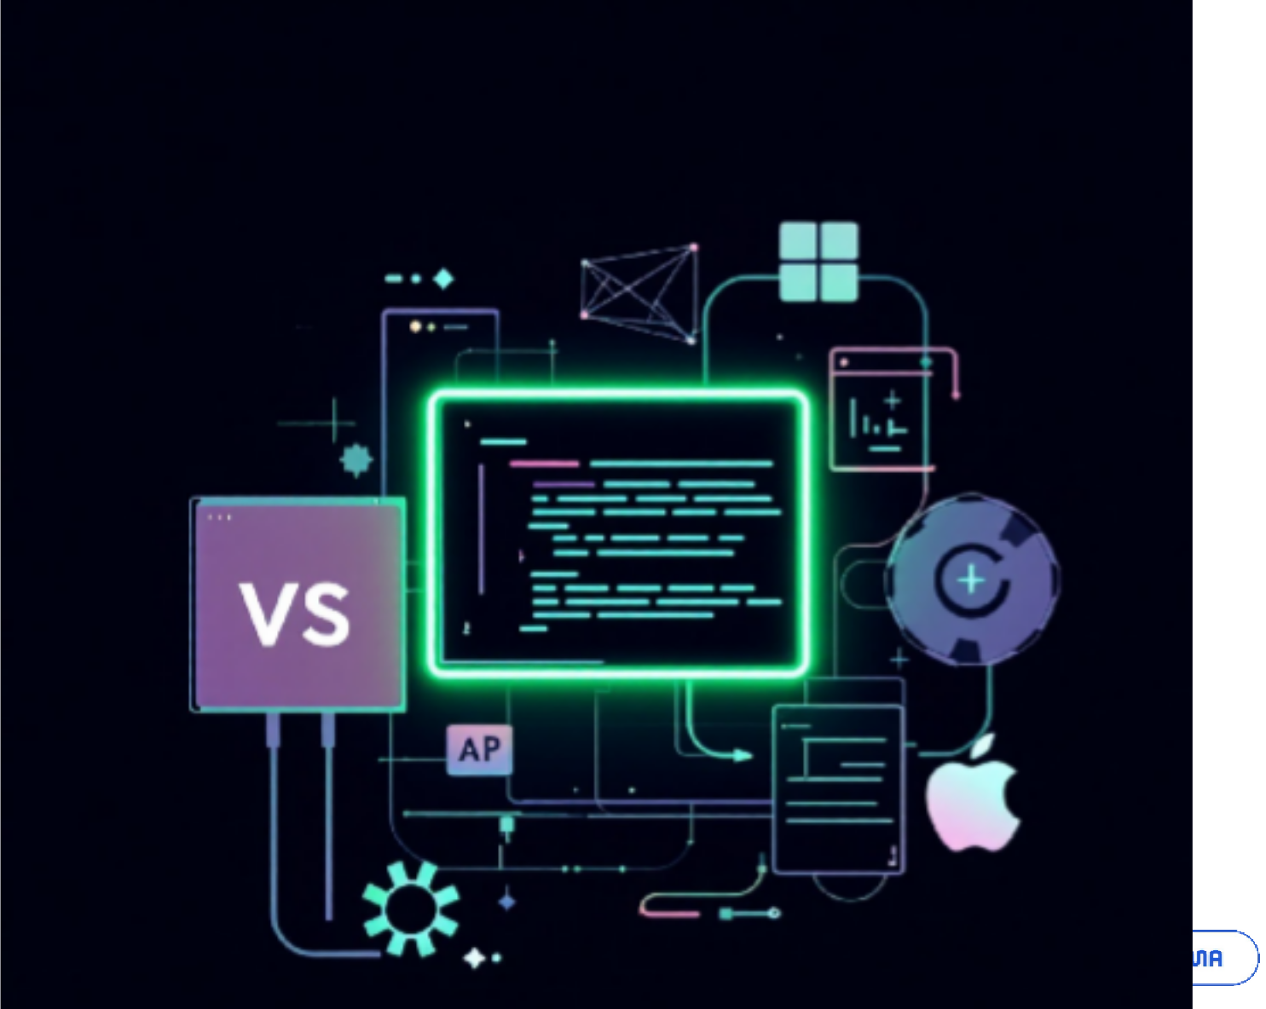
Tools & Technologies Used: The Frontend Stack
HTML5
The foundational language for structuring web content, ensuring semantic and accessible markup.
CSS3
Used for styling the portal, creating a visually appealing and responsive user interface.
JavaScript
Vanilla JS powers all interactive elements and client-side logic.
Development Environment
Modern Web Browser (Chrome / Edge) for testing and deployment.
Code Editor (VS Code, Sublime Text, etc.) for efficient coding.

Slide 5





System Design: Modular Architecture
Login Portal
The entry point, offering distinct paths for student and staff authentication.
Student Module
Allows students to securely log in, browse, and search for books.
Staff Module
Provides staff with privileged access to manage library inventory.
Book Management
A central section displaying all available books with real-time updates.

Slide 6

Login Functionality: Secure Access
Student Login
Username: student01
Password: pass123
Access: View and Search Books

Slide 7

Book Management Features: Dynamic Inventory
All book data is efficiently stored and managed within a JavaScript array, ensuring fast client-side operations.
For Staff:
Add new books (Title, Author)
Delete existing book records
For Students:
View all available books
Search books by author name
The system ensures real-time updates to the book table without requiring a page reload, enhancing user experience.

Slide 8
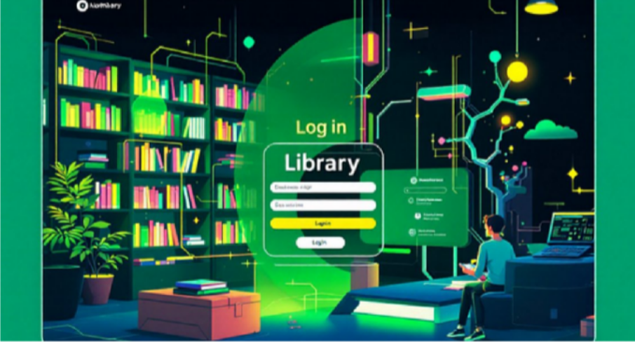
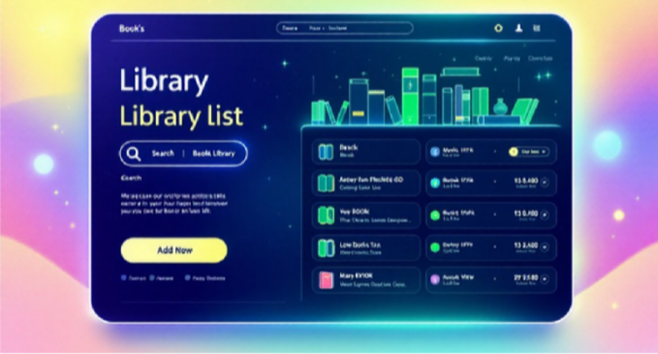
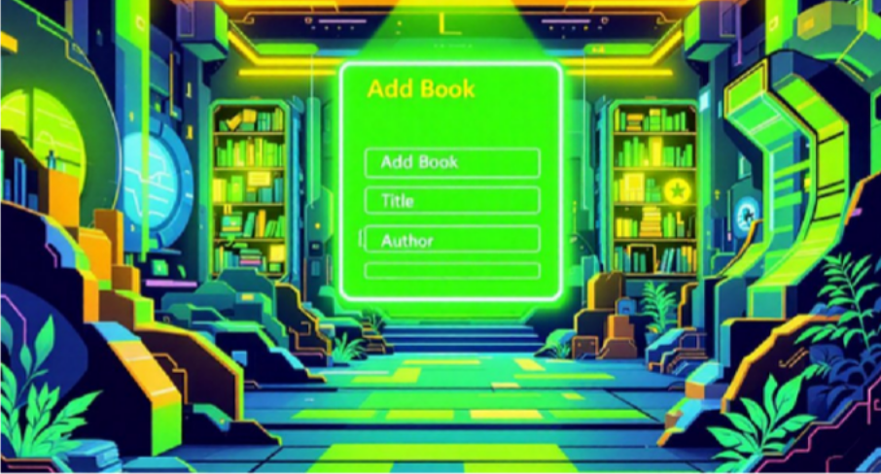
User Interface: Clean & Responsive Design
The portal features a , prioritizing user experience with clear navigation and responsive layouts.
Optimized spacing and typography for readability across devices.
Intuitive button styling with clear color coding:
Green: Add
For adding new entries or confirming actions.
Blue: Login / Borrow
Used for authentication and book lending functions.
Red: Delete
Indicates actions to remove entries or cancel operations.
Dynamic tables update book records instantly, providing immediate feedback to users.

Slide 9



Advantages & Future Enhancements
Current Advantages
User-Friendly
Future Enhancements
Simple and intuitive interface for all users.
Database Integration
Lightweight
Connect to a robust backend (e.g., MySQL, Firebase) for persistent data storage.
Fast performance due to no backend or database dependencies.
Basic Security
Fundamental credential-based login for access control.
Advanced User Management
Implement user registration, password encryption, and recovery features.
Issue/Return System
Develop functionality for tracking book loans and returns.
Enhanced Metadata
Add book categories, detailed borrowing history, and advanced search filters.

Slide 10

Conclusion: A Foundation for Digital Libraries
The Library Login Portal successfully delivers a basic, yet functional demonstration of a digital library system.
It effectively showcases key frontend web development concepts, including:
HTML structure for content organization.
CSS design for aesthetic appeal and responsiveness.
JavaScript interactivity for dynamic user experiences.
This project serves as a strong foundation, with significant scope for expansion into a complete library management system through future backend integration and advanced feature development.

Slide 11
Library Login Portal
A Simple Web-Based Library Management System
Presented by: [Your Name], [Roll Number], [Class] Course: Web Technologies / Mini Project Institution: [Institution Name]

